Slide 1
IS 607
Final Project

Slide 2
Background and Motivation
Lending Club is a US based company that facilitate a peer-to-peer lending market
The FED publishes the outstanding consumer credit amount against depository institutions on the monthly basis
I have a professional background in the area of credit risk and therefore I am interested in the growth of peer-to-peer lending

Slide 3
Data and Challenges
The Lending Club data contains loans originated between June 2007 and Dec 2011. It is in a CSV format.
The FED Depository Institutions outstanding consumer credit data is published monthly and posted to a table on the FED website.
The CSV file needed some cleaning up beforehand and one field was removed
The FED data appeared as a list of lists out of the ‘readHTMLTable()’ function so there was some work to get it into a data frame
There was an order of magnitude issue between the two sets of numbers, so I needed to apply a log scale for the comparison

Slide 4
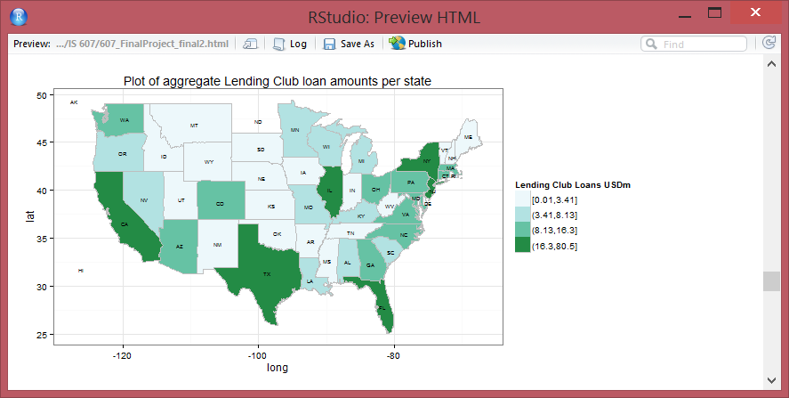
Findings

Slide 5
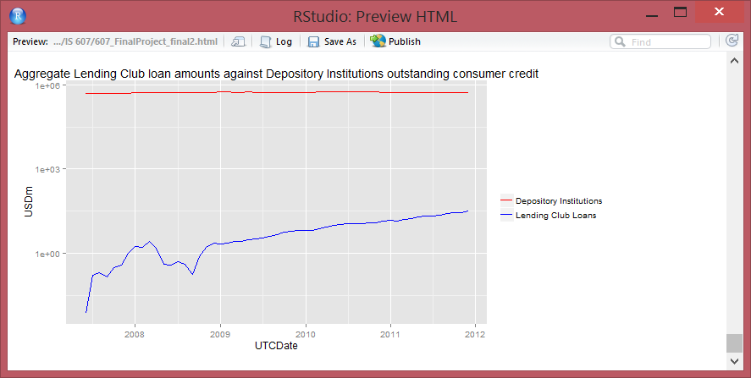
Findings

